Slide 1
Unit 01 Introduction to basics of C++
ThanhNT v1.0

Slide 2
Goals
Share basics of C++
Understand differences between C and C++
Run some lines of C++ code

Slide 3
Outline
Getting started
C++ basics
Basic syntax
C versus C++
Input and output
Pointer
String
Reference variable
Namespace
Handling errors

Slide 4
For references
learncpp.com
tutorialspoint.com/cplusplus
Google-sama

Slide 5
Getting Started

Slide 6
Why?
C++ is very popular
Knew C, why not C++?
New works, new opportunities
Notes:
C++ is very popular
#3 in Tiobe's top programing languages (http://www.tiobe.com/tiobe_index)
Knew C, why not C++?
Code reuse aka knowledge reuse aka brain reuse
We need food
FGA.BU18 is still different to FSU1.BU16

Slide 7
How?
Any text editor and any C++ compiler
g++ -c
g++ -o
Any completed C++ IDE
Notes:
Any text editor and any C++ compiler
Classic notepad or modern Sublime… etc
GNU C/C++ compiler
Any completed C++ IDE
Microsoft Visual Studio, Xcode, Eclipse… etc
Dev-C++, Code::Block… etc

Slide 8
What?
C++ was developed by Bjarne Stroustrup at Bell Labs, starting in 1979
As an extension to C
C++ adds many new features
It is an object-oriented language

Slide 9
C++ Basics

Slide 10
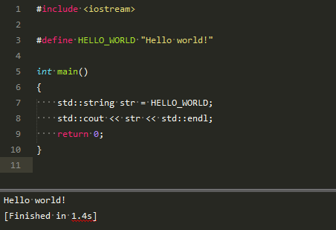
Basic Syntax

Slide 11
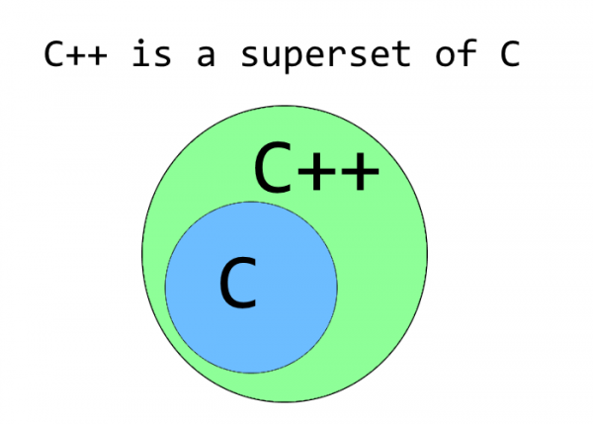
C versus C++

Slide 12
C versus C++ (continue)
C | C++
C is a subset of C++ | C++ is a superset of C
Procedural programming paradigm | Both procedural and object oriented programming paradigms
Function driven language | Object driven language
No polymorphism, encapsulation, and inheritance | Of course, yes
Data and functions are separate and free entities | Data and functions are encapsulated together in form of an object
No information hiding | Of course, yes
Notes:
C++ can run most of C code while C cannot run C++ code

Slide 13
C versus C++ (continue)
C | C++
No function and operator overloading | Of course, yes
Not allow functions to be defined inside structures | Of course, yes
No namespace | Of course, yes
No reference variable | Of course, yes
No virtual and friend functions | Of course, yes
‘malloc’ and ‘free’ | ‘new’ and ‘delete’
No direct support for error handling | Of course, yes
Notes:
C++ can run most of C code while C cannot run C++ code

Slide 14
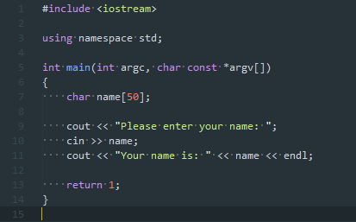
Basic Input and output
Why?
Only has to learn how to interact with the streams with many different kinds of devices
Left the details to the environment or operating system
How?
C++ language provides input and output functionality through the C++ standard library
What?
Notes:
Abstractly, a stream is just a sequence of characters that can be accessed sequentially
Typically we deal with two different types of streams:
Input streams are used to hold input from a data producer with extraction operator (>>)
output streams are used to hold output for a particular data consumer with insertion operator (<<)
Standard streams in C++
cin - standard input
cout -- standard output
cerr -- standard error (unbuffered output)
clog -- standard error (buffered output)
Unbuffered output is typically handled immediately, whereas buffered output is typically stored and written out as a block
The Standard C runtime library uses stdio. The Standard C++ runtime library uses iostream. Because C++ is largely a superset of C, it includes the C stanard library, so stdio based code works.

Slide 15
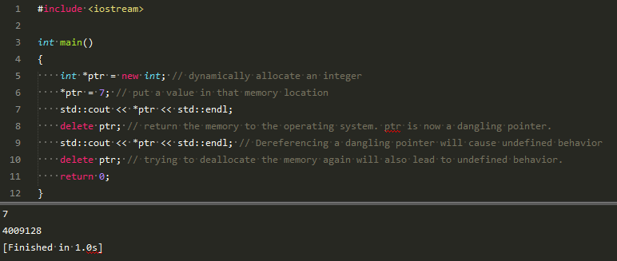
Pointer
Why?
Pointer is typically seen as one of the most important parts of C/C++
How?
Using operator ‘new’ and ‘delete’ to dynamically allocate single variables
What?
Notes:
Operator new and delete allow us to dynamically allocate single variables for our programs.
Dynamically allocated memory has no scope and will stay allocated until you deallocate it or the program terminates.
Be careful not to dereference dangling or null pointers.

Slide 16
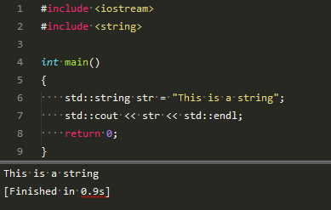
String
Why?
This is C++, not C
String of C++ is easier, safer, and more flexible
How?
C++ includes a built-in string data type as part of the standard library
What?
Notes:
No more memory management, no more weird function names, and a much reduced potential for disaster.
When using operator >> to extract a string from cin, operator >> only returns characters up to the first whitespace it encounters. Any other characters are left inside cin, waiting for the next extraction.

Slide 17
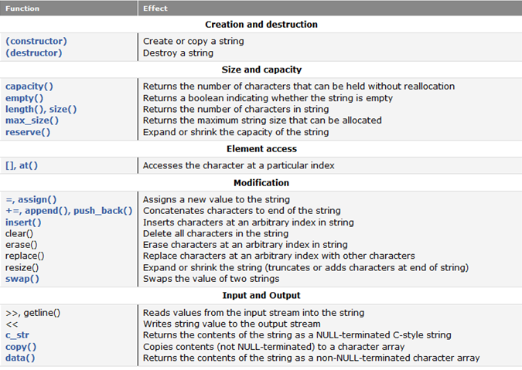
String (continue)

Slide 18
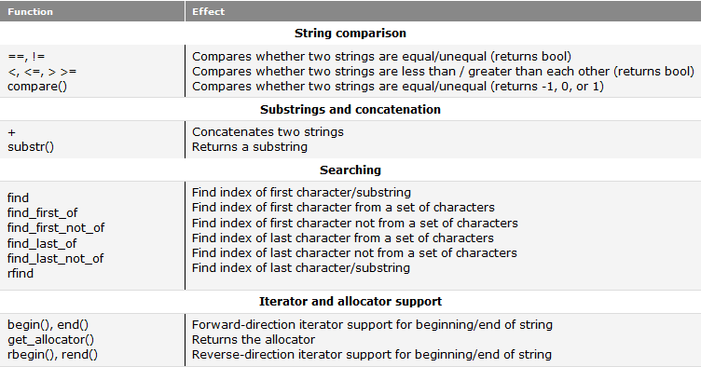
String (continue)

Slide 19

Reference variable
Why?
Sometimes you don’t want to use pointer
How?
C++ creates an alias to an initialized variable
Similar but still different to pointer
No NULL references
Can’t refer to another object
Must be initialized when it is created
What?

Slide 20
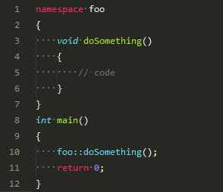
Namespace
Why?
Resolve the conflict that two identifiers with the same name into the same scope
How?
Define an area of code in which all identifiers are guaranteed to be unique
What?
Notes:
By default, global variables and normal functions are defined in the global namespace

Slide 21
Handling errors
Why?
When writing programs, there are always different kinds of errors
Errors should be commonly handled
How?
Identify areas where assumptions may be violated
Write code that detects and handles any violation of those assumptions
What?
Detecting assumption errors
Handling assumption errors
Assert and NDEBUG
Exceptions
Notes:
Two categories: syntax and semantic errors
A syntax error occurs when you write a statement that is not valid according to the grammar of the C++ language
A semantic error occurs when a statement is syntactically valid, but does not do what the programmer intended
A logic error occurs when the programmer incorrectly codes the logic of a statement
A violated assumption occurs when the programmer assumes that something will be either true or false, and it isn’t
Defensive programming is a form of program design that involves trying to identify areas where assumptions may be violated, and writing code that detects and handles any violation of those assumptions so that the program reacts in a predictable way when those violations do occur.
C++ provides one more method for detecting and handling errors known as exception handling. The basic idea is that when an error occurs, the error is “thrown”. If the current function does not “catch” the error, the caller of the function has a chance to catch the error. If the caller does not catch the error, the caller’s caller has a chance to catch the error. The error progressively moves up the stack until it is either caught and handled, or until main() fails to handle the error. If nobody handles the error, the program typically terminates with an exception error.

Slide 22
Q&A
Thanks!

